Slide 1

EPL POINTS PREDICTION
Using Machine Learning

Slide 2

-Mayank Tejan (A41105221038)

Slide 3
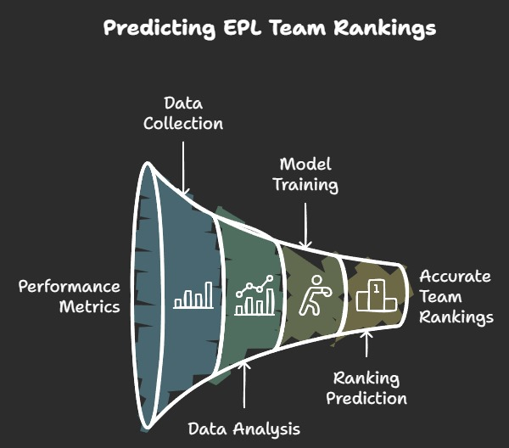
Overview
The project aims to build a predictive model to forecast the English Premier League (EPL) point table using historical team and match data.
Machine learning techniques were employed to predict the performance of EPL teams based on various features like past results, player statistics, and other relevant factors.
The project utilizes data scraping, feature engineering, and multiple machine learning algorithms to make accurate predictions about the final standings.

Slide 4
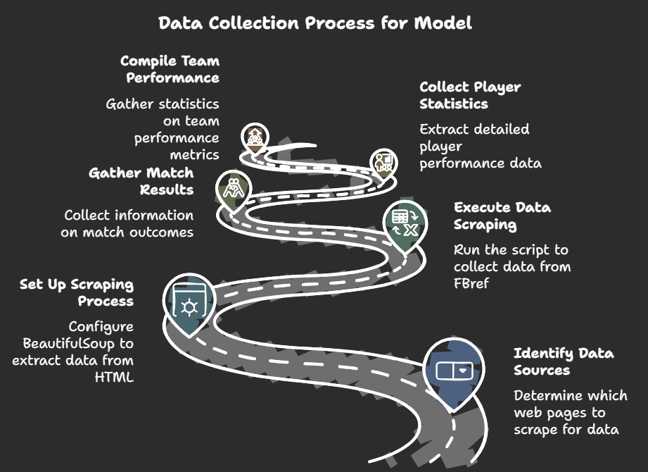
Data Collection
Source:
Data was gathered from FBref using BeautifulSoup, a Python library for web scraping. FBref provides detailed statistics such as team performance, player statistics, match results, and historical data.
Challenges:
Web Scraping Ban: Initially, the scraping process faced challenges due to getting banned from FBref for too many requests in a short period. This required the implementation of rate-limiting and the use of proxies to avoid future bans.
Data Access: Some pages were dynamically loaded, requiring advanced techniques like handling JavaScript or using Selenium for scraping.
Data Integrity: Ensuring data was accurate and consistent across all scraped pages was challenging due to occasional missing or inconsistent data.

Slide 5
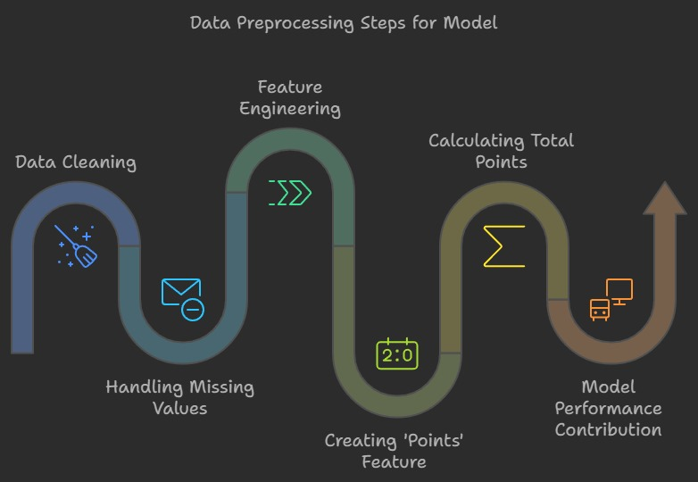
Cleaned data by:
Removing duplicate rows.
Handling missing values (using imputation techniques or removing rows where data was missing).
Ensuring all columns had consistent formatting (e.g., date formatting, numerical values).
Extracted key features from raw data, such as:
Team names, match dates, goals scored, goals conceded, home/away status, etc.
Player statistics and performance metrics from match logs.
Head-to-head results between teams.
Feature Engineering:
A new feature, Points, was created based on the match result:
Win: 3 points
Loss: 0 points
Draw: 1 point
This feature allowed the model to compute the total points for teams at the end of the season, enabling the prediction of final standings
Pre Processing
Cleaning and Feature Engineering
78
BAR GRAPH INFO 1
BAR GRAPH INFO 1
BAR GRAPH INFO 1

Slide 6
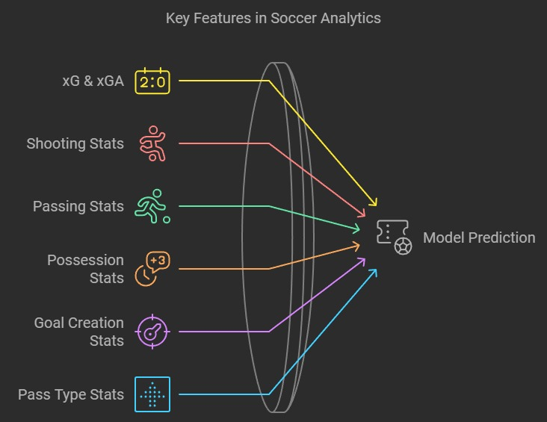
xG-expected goals GA- goals allowed
xGA-expected allowed goals
Poss- possession of the ball
GF- goals scored
Shooting stats-
Sh- total number of shots PKatt- penalty kicks attempted
SoT- shots on target
Dist- average distance in yards from goal of all shots taken
FK- shots from freekick
PK- penalty kicks made
Passing stats Possession stats-
KP-passes that directly lead to a shot Att 3rd
⅓-passes that enter the ⅓ of the pitch AttPen-touches in atk pen area
PPA- passes into the 18-yard box Prog-prog passes recieved
CrsPA- completed crosse into the 18-yard
Goal and Shot Creation stats- SCA- shot-creating actions
Features for Model Prediction
-touches in atk ⅓ of the pitch

Slide 7
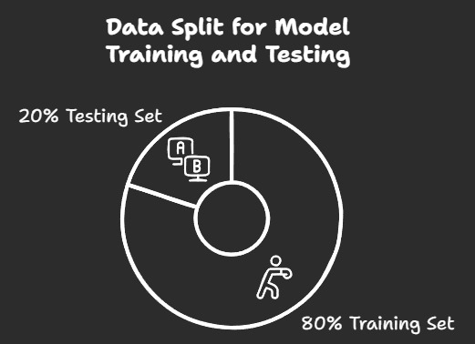
Training & Testing
The final dataset was created by combining multiple tables scraped from different pages (e.g., match results, player statistics, team standings).
These tables were merged on common columns like team name and match date.
The final CSV file included:
Columns for team name, match results, goals scored, goals conceded, points, and other relevant statistics.
Ensured all data was in the correct format for input into machine learning models (numerical values, categorical features encoded appropriately).

Slide 8
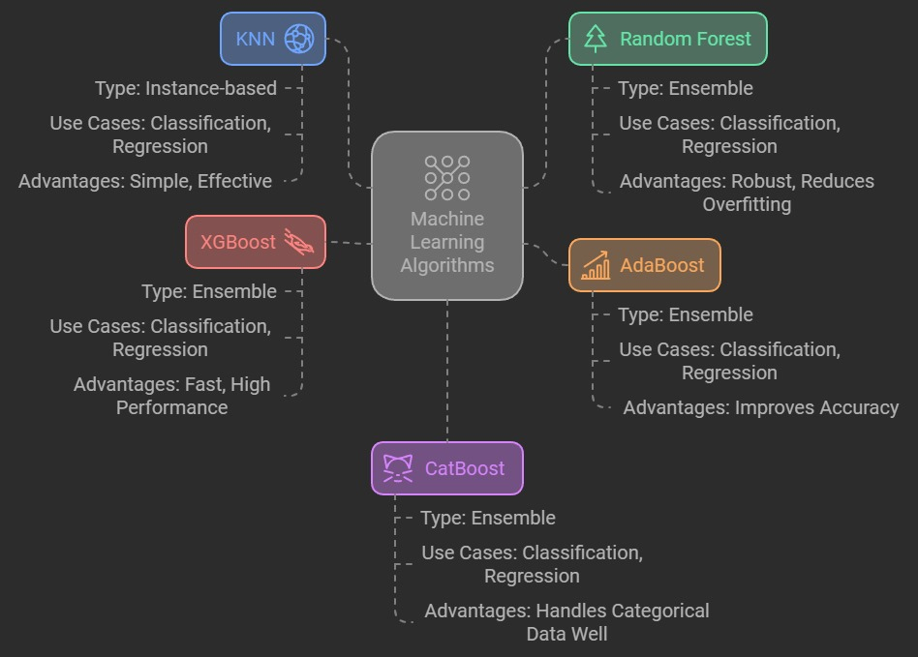
Machine Learning Models Used
Seven different machine learning algorithms were used to build the model:
K-Nearest Neighbors (KNN): A simple algorithm that uses distance metrics to classify data points based on nearest neighbors.
Random Forest: A powerful ensemble technique that uses multiple decision trees to improve prediction accuracy.
AdaBoost: An ensemble technique that adjusts the weights of misclassified data points to improve performance.
XGBoost: An optimized gradient boosting method that is highly effective for structured/tabular data.
CatBoost: A gradient boosting method optimized for categorical features.
Decision Tree: A machine learning model that splits data into branches based on feature values to make predictions, resembling a tree structure.
Gradient Boosting Regressor: An ensemble method that builds a series of weak learners (typically decision trees) and combines them to improve prediction accuracy by focusing on errors made by previous trees.

Slide 9
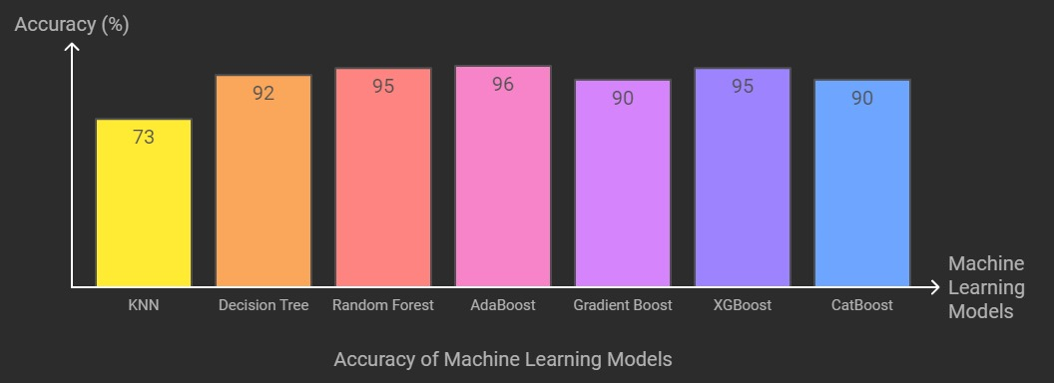
Accuracy Comparison of ML Models
KNN: 73% accuracy
Random Forest: 95% accuracy
AdaBoost: 96% accuracy
XGBoost: 95% accuracy (best performer)
CatBoost: 90% accuracy
Overall Best Model: ADABoost performed the best, with 96% accuracy, making it the final choice for predictions.

Slide 10
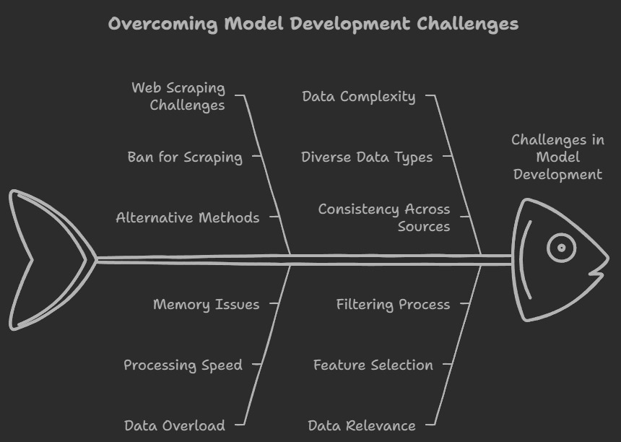
Challenges
Web Scraping Ban: Encountered issues with scraping restrictions and bans, which required mitigating strategies.
Large Data Volumes: The volume of data from FBref made processing slow, requiring optimized data storage and handling techniques.
Complex Data: Features like player statistics and head-to-head results required careful extraction and transformation to be usable.
Data Relevance: Some features were not directly relevant to predicting outcomes, requiring feature selection to improve model performance.

Slide 11
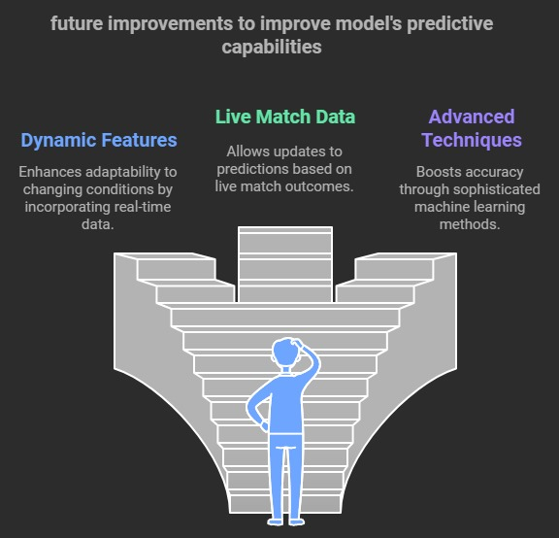
Dynamic Features: Incorporating live match data, player injuries, and transfers to adjust predictions in real time.
Advanced Feature Engineering: Exploring more complex features such as player form, home/away advantages, and more granular statistics.
Ensemble Models: Combining multiple machine learning models to improve predictions further.
Real-Time Data Integration: Automating data collection and model updates using live feeds to ensure continuous model accuracy.
Additional Algorithms: Experimenting with deep learning techniques or hybrid models for even better performance.

Slide 12
Conclusion
The project successfully built a machine learning model that predicts EPL standings with 96% accuracy using historical data.
The model demonstrates the power of machine learning in sports analytics and could potentially be applied to other leagues or sports.
Future improvements, such as incorporating dynamic features and live data, could enhance its performance and make it more adaptable for real-time predictions.

Slide 13
References
Adhatrao, K., Gaykar, A., Dhawan, A., Jha, R. & Honrao, V. Predicting students’ performance using ID3 and C4.5 classification algorithms. International Journal of Data Mining & Knowledge Management Process, 3(5), 2013, 39-52.
Buursma, D.,Predicting sports event from past result: Towards effective betting on football matches. Preceding 14thTwente Student Conference on IT. University of Twente, Faculty Electrical Engineering, Mathematics and Computer Science, Netherlands, 2011. Retrieved:http://referaat.cs.utwente.nl/conference/14/paper/7226/predicting-sports-events-from-past-results.pdf
Farzin, O., Parinaz, E., & Faezeh, S. M. Football result prediction with Bayesian network in Spanish league-Barcelona team. International Journal of Computer Theory and Engineering, 5(5), 2013, 812-815.
Baio, G. & Blangiardo, M. Bayesian hierarchical model for prediction of football results. Discovery, University College London., 2010, retrieved from http:discovery.ucl.ac.uk.
Nivard, W. & Mei, R. D.Soccer analytics: Predicting the of soccer matches. (Master thesis: UV University of Amsterdam), 2012,Retrieved from www.few.vu.nl/en/Images/werkstuk-wijk_tcm39-315158.pdf
Courneya, K. S., & Carron, A. V. The home advantage in sport competitions: A literature review. Journal of Sport and Exercise Psychology, 14(1), 1999, 13-27.

Slide 14
References
Clarke, S. R. & Norman, J. M. Home ground advantage of individual clubs in English football. Statistician, 44, 1995, 509521
Webby, R. & O’Connor, M.. Judgmental and statistical time series forecasting: a review of the literature. International Journal of’ Forecasting 12, 1996, 91-118
Bing Shen Choi, Lee Kien Foo. Predicting Football Match Outcomes With Machine Learning Approaches. Multimedia University - MMU Cyberjaya, Malaysia
FBref.com. Football statistics and history for the English Premier League current season i.e 2024/25. https://fbref.com/en/comps/9/Premier-League-Stats (accessed 06 November 2024).
Fátima Rodrigues , Ângelo Pinto. Prediction of football match results with Machine Learning. Interdisciplinary Studies Research Center (ISRC), Polytechnic of Porto - School of Engineering, Porto, Portugal Polytechnic of Porto - School of Engineering, Rua Dr. António Bernardino de Almeida, Porto, Portugal. International Conference on Industry Sciences and Computer Science Innovation.
Tax, N., & Joustra, Y., "Predicting the Dutch football competition using public data: A machine learning approach," arXiv preprint arXiv:1603.00772, 2016.

Slide 15
THANK YOU

